Slide 1



Weather's Impact on Pedestrian Behavior:
the case of Shibuya Scramble Crossing
Bao Doan Minh
School of Environment and Society,
Tokyo Institute of Technology
2024/08/05

Slide 2
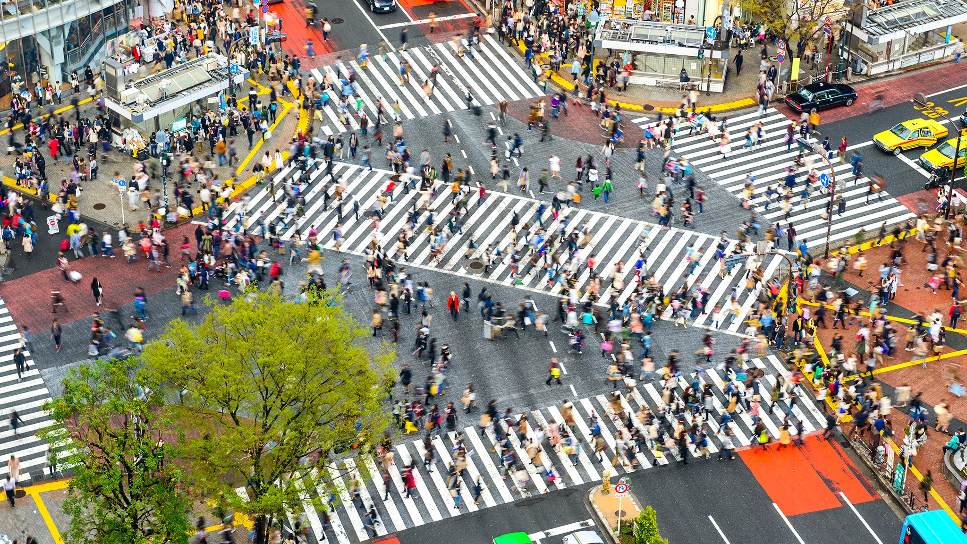
INTRODUCTION
Shibuya Scramble Crossing

Slide 3
INTRODUCTION
Benefit
Understanding how weather affects pedestrian behavior can lead to better design of walkways, crosswalks, and public spaces to enhance safety in various weather conditions.
Retailers can understand how weather impacts foot traffic, helping them plan promotions, staffing, and inventory management more effectively.
Insights into pedestrian behavior during different weather conditions can help optimize traffic light timings and pedestrian crossing intervals, improving overall traffic flow.
Businesses can make better decisions about where to locate new stores or services based on pedestrian patterns in different weather conditions.

Slide 4
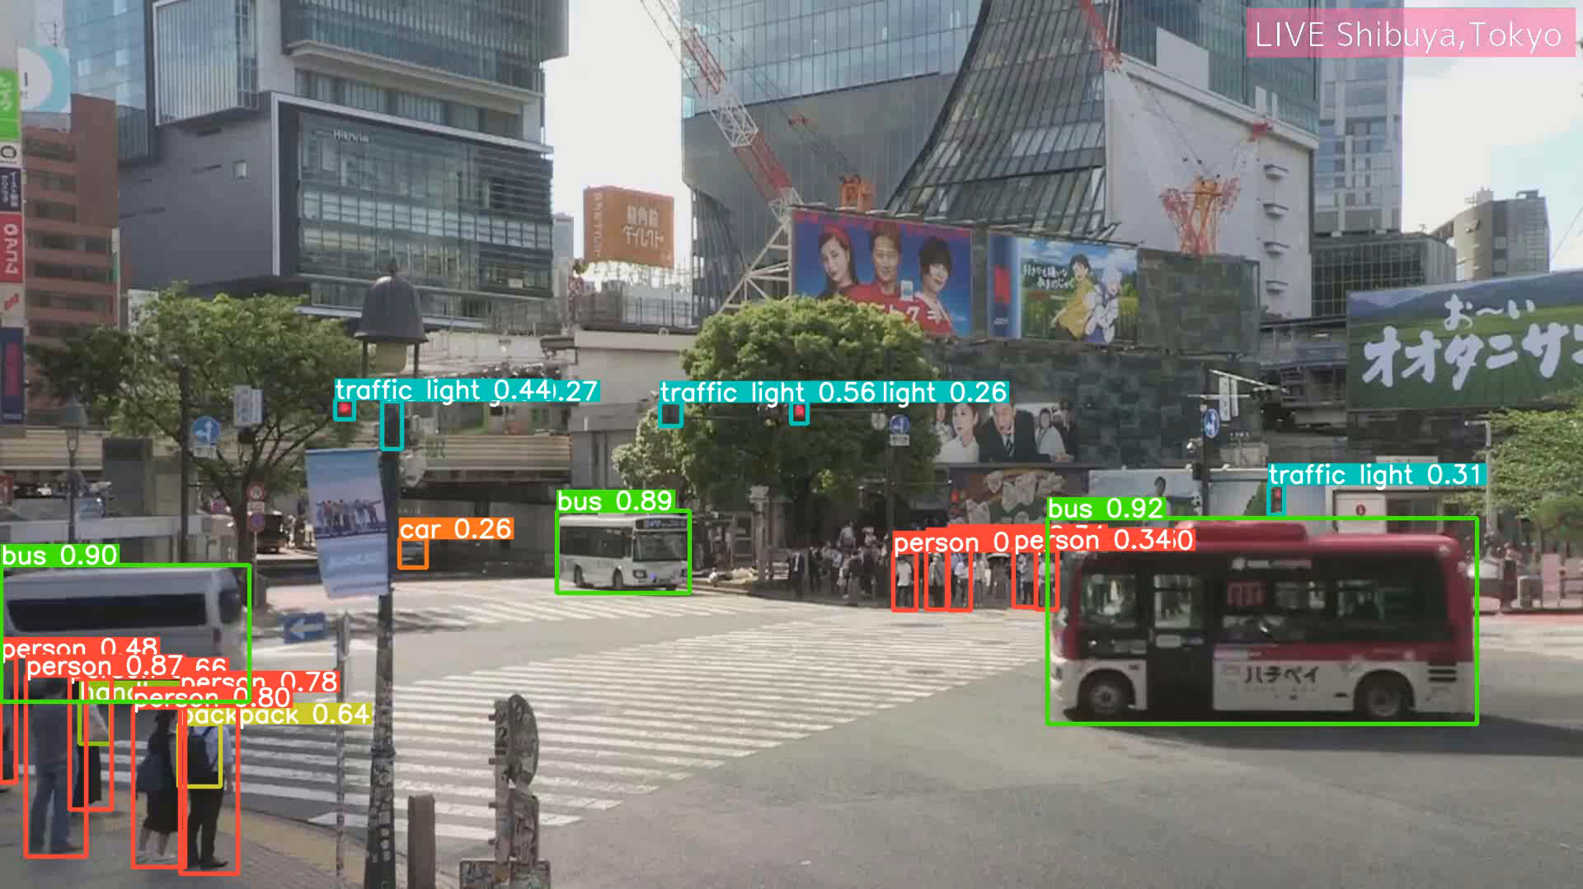
METHOD
YOLOv5 Model

Slide 5
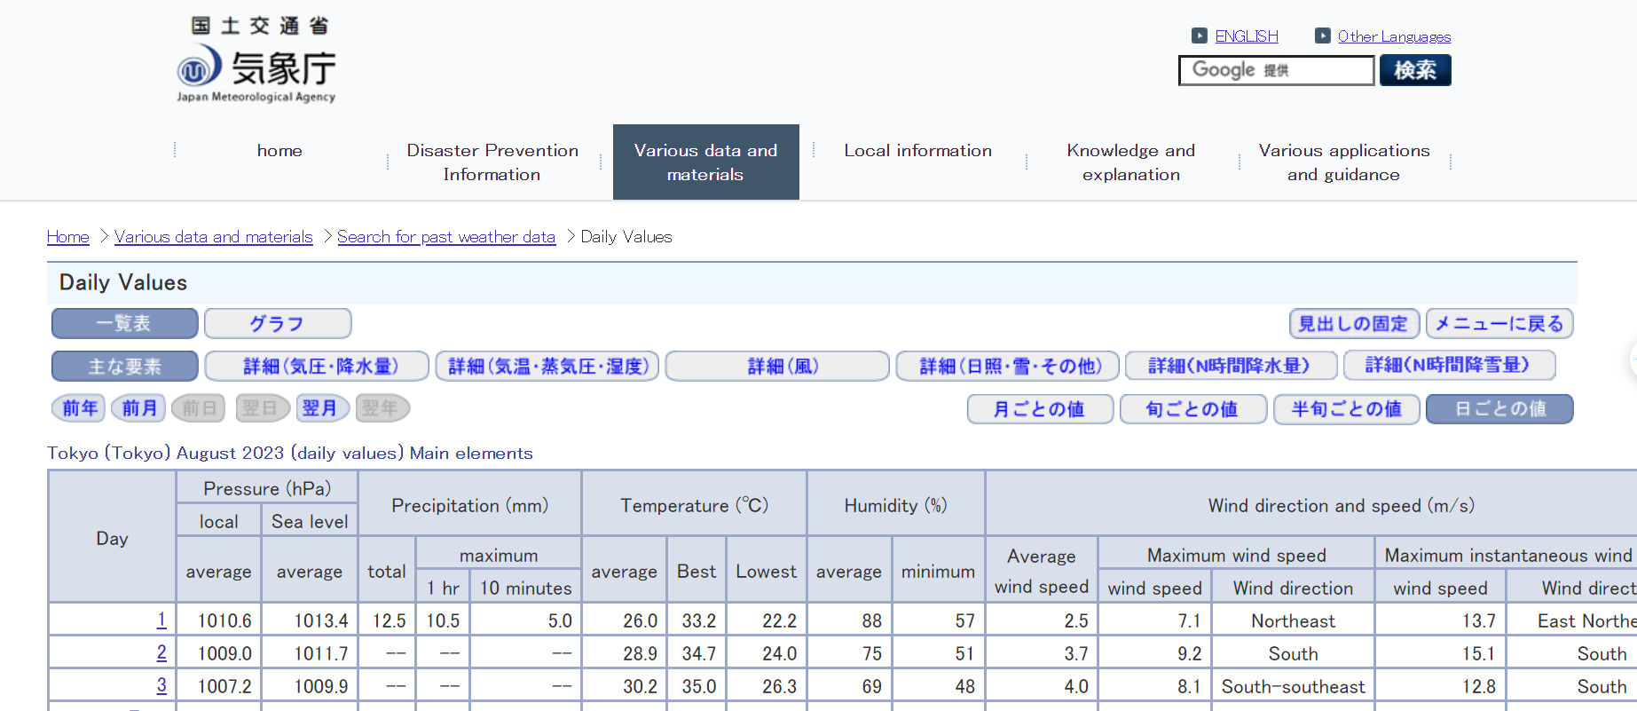
METHOD
Japan Meteorological Agency
The data spans from July 28, 2023, to December 31, 2023, and covers the time period from 8:00 AM to 4:00 PM in Tokyo.

Slide 6
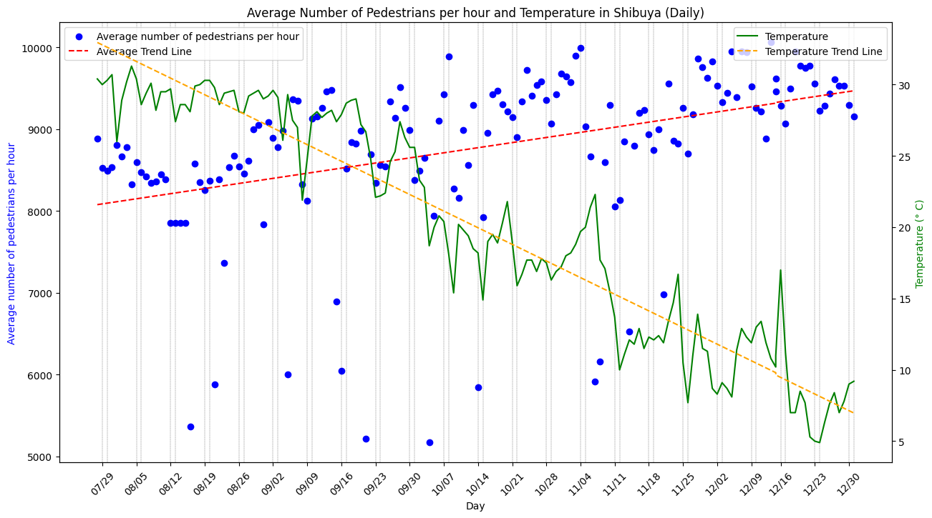
INSIGHT
Temperature’s Impact
The average number of pedestrians crossing Shibuya street shows a moderate negative linear correlation with temperature (-0.39), indicating that as temperatures decrease, there is a noticeable tendency for more pedestrians to be observed crossing the street.

Slide 7
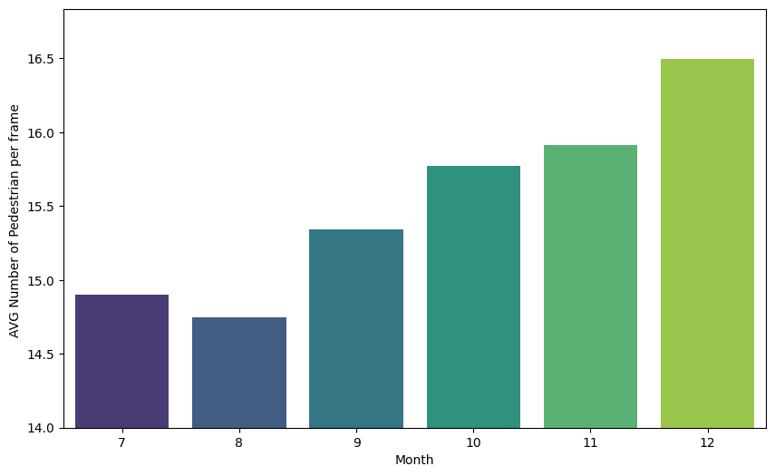
INSIGHT
Temperature’s Impact

Slide 8
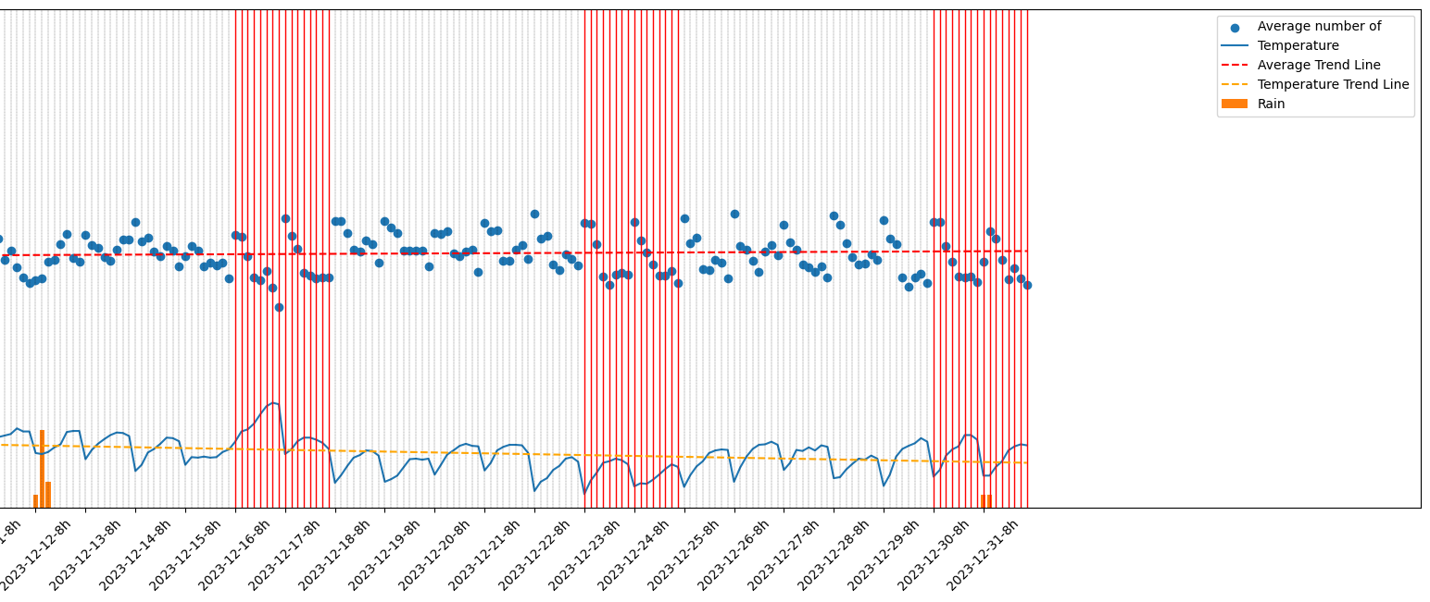
INSIGHT
Hourly analysis

Slide 9
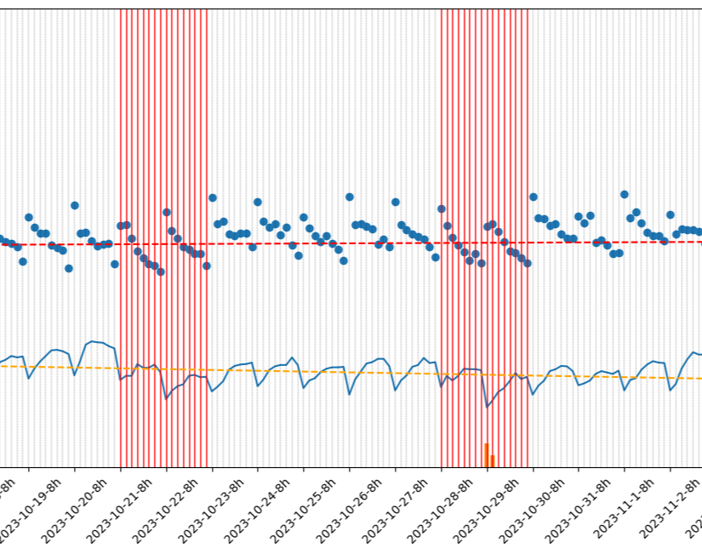
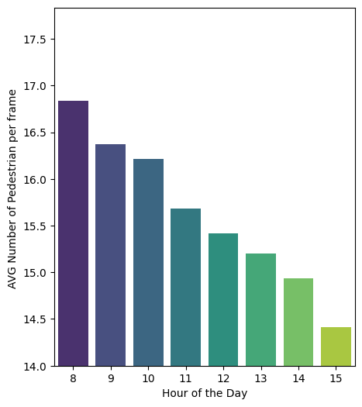
INSIGHT
Day hour’s Impact
Hour | AVG Number of Pedestrian per frame
8 | 16.84
9 | 16.37
10 | 16.21
11 | 15.68
12 | 15.42
1 | 15.2
2 | 14.93
3 | 14.41

Slide 10
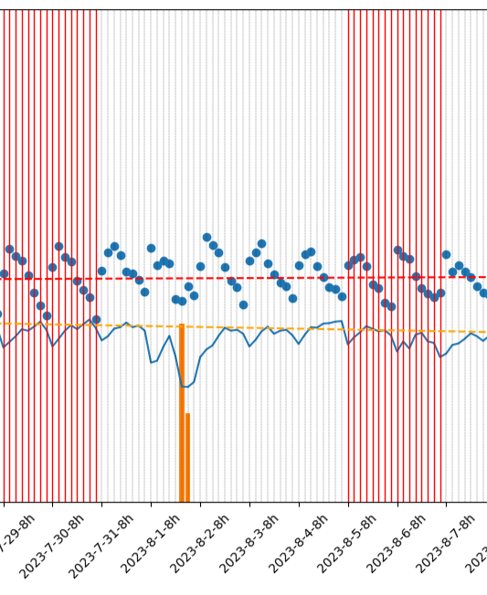
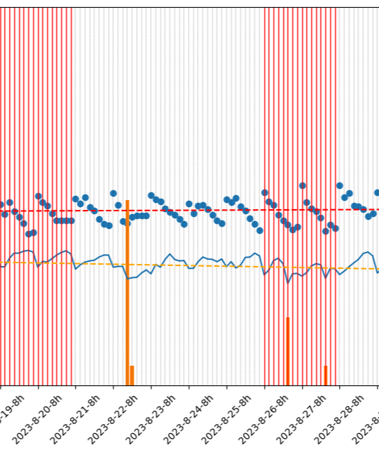
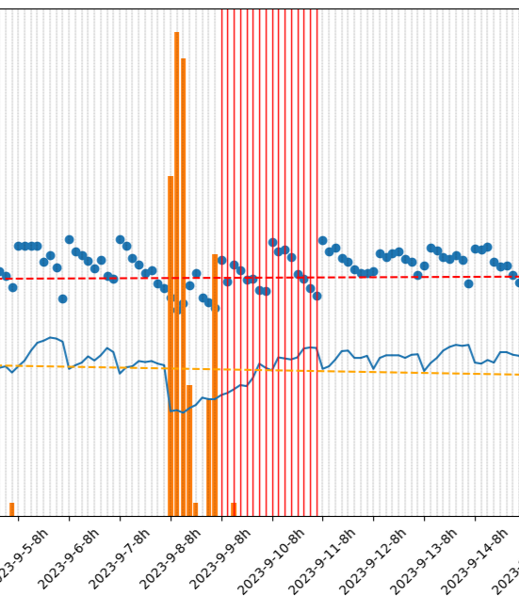
INSIGHT
Rain impact: break the usual pattern

Slide 11
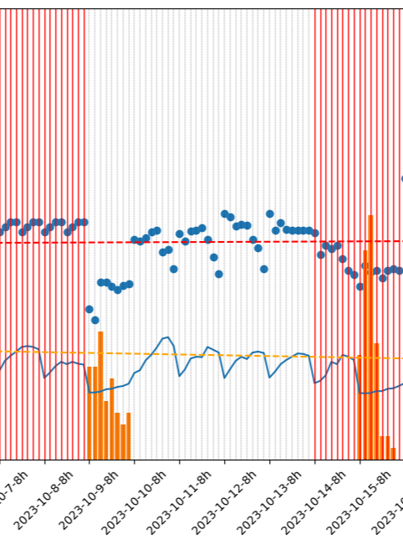
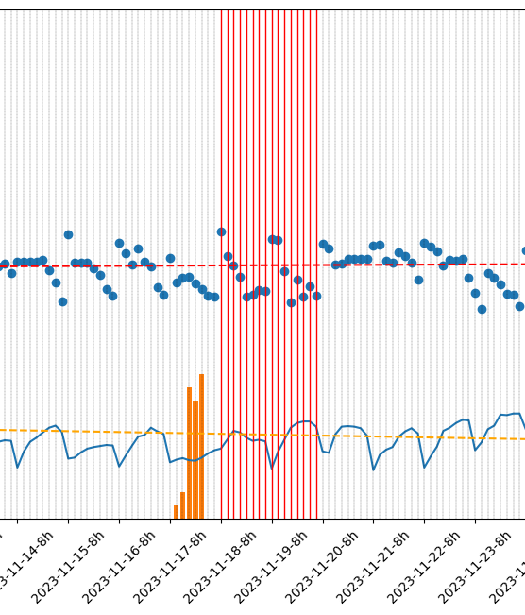
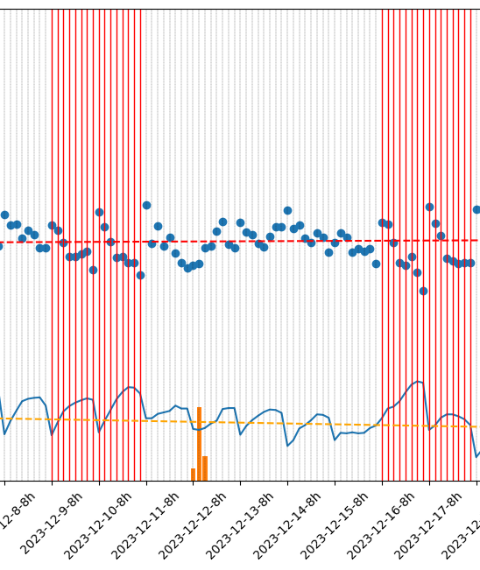
INSIGHT
Rain impact: break the usual pattern

Slide 12
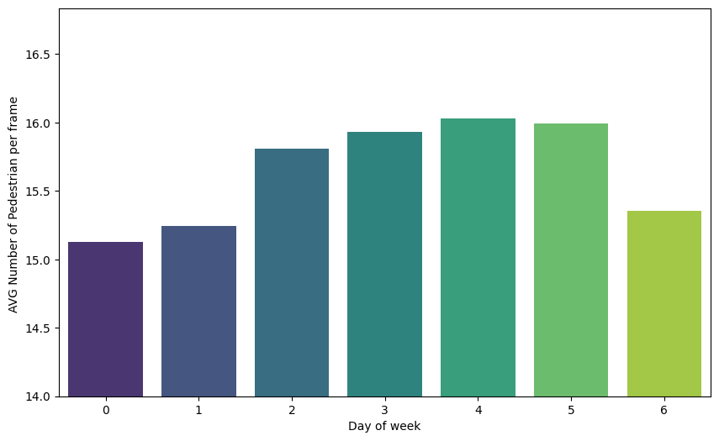
INSIGHT
Day of week

Slide 13
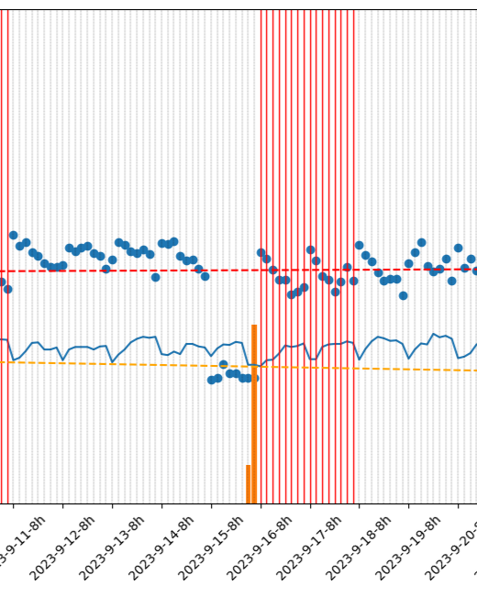
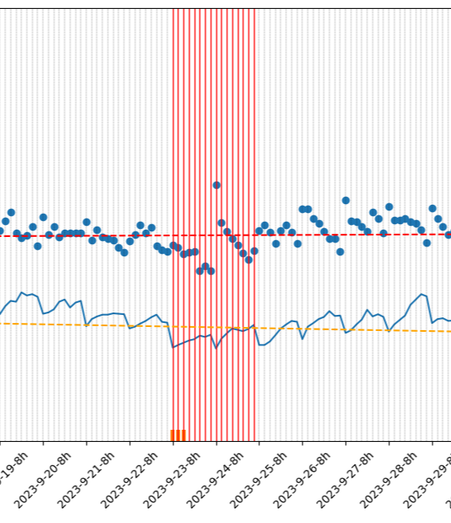
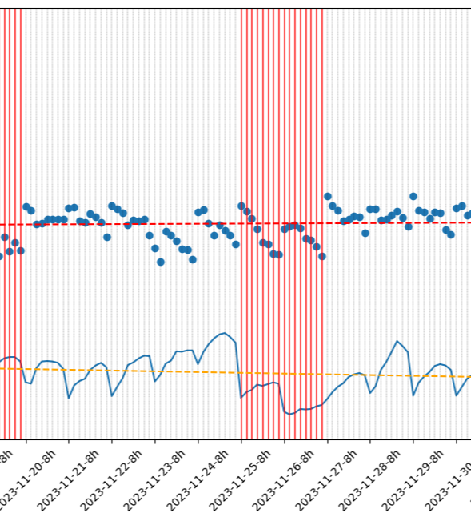
INSIGHT
Holiday
15/9 - Respect for the Aged Day (keiro no hi)
23/9 - Autumn Equinox Day (shubun no hi)
23/11 - Labor Thanksgiving Day (kinro kansha no hi)

Slide 14
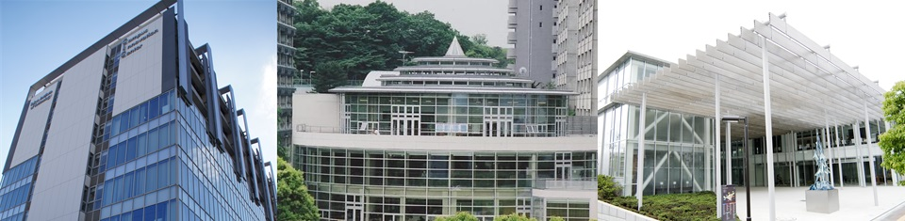
Thank You

